Slide 1

Pandamo – Data Science for Dynamo

Slide 2

metaspace specialise in product development for AECO.
Build cloud, web & generative design apps
Connect & extend your existing design and project management tools
Adopt modern development practices for your team
About metaspace

Slide 3

Disclaimer
This is an experimental pre-alpha-beta-alpha package
If anything breaks during this presentation, I will blame one of the following:
Dynamo!
Autodesk
My laptop
The weather

Slide 4

AEC 2019 Presentation – Machine Learning

Slide 5

Machine Learning is “Easy!”

Slide 6
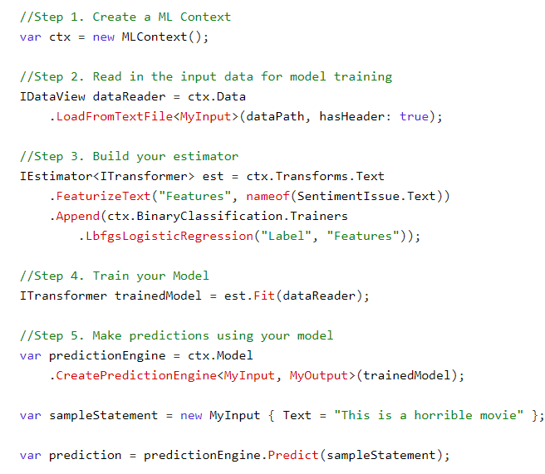
ML in C#

Slide 7
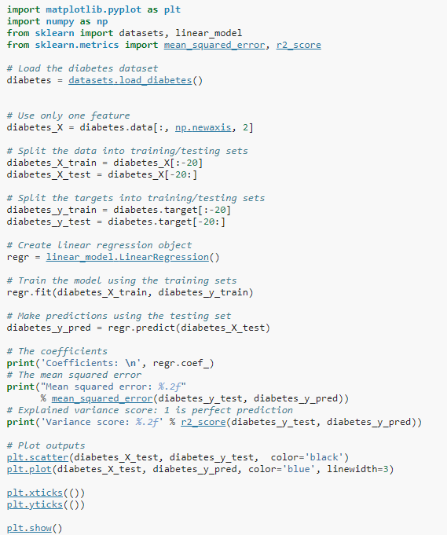
ML in Python (Scikit-Learn)

Slide 8
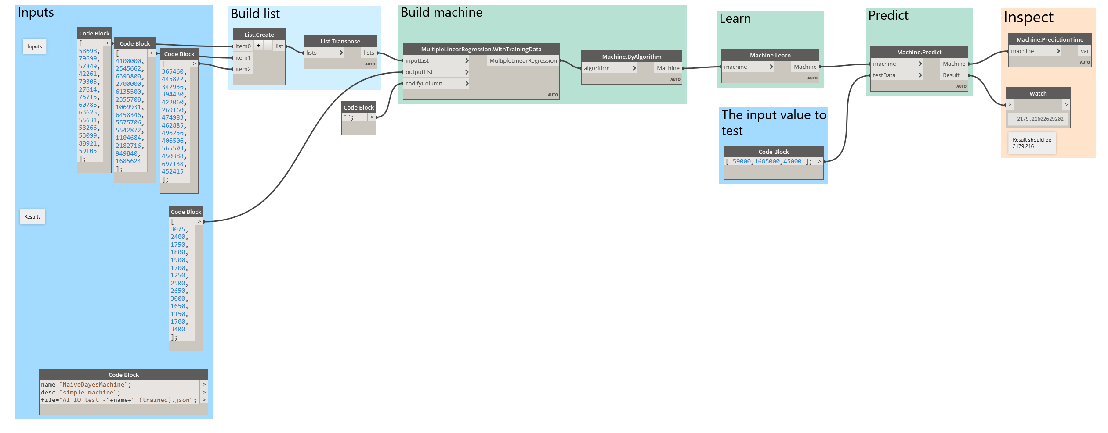
ML in Dynamo (DynAI)

Slide 9

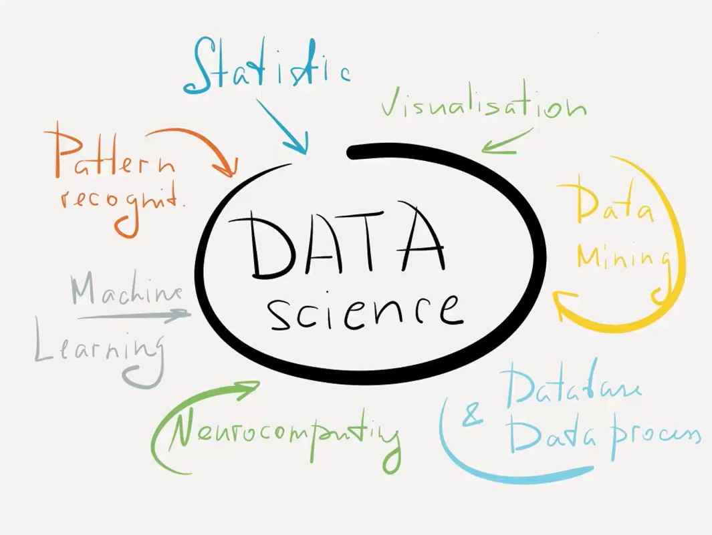
The Difficult Part!

Slide 10
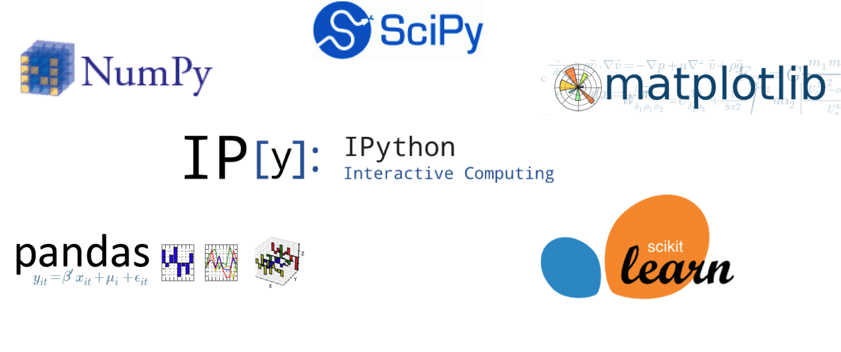
Python is the most popular language in Data Science

Slide 11
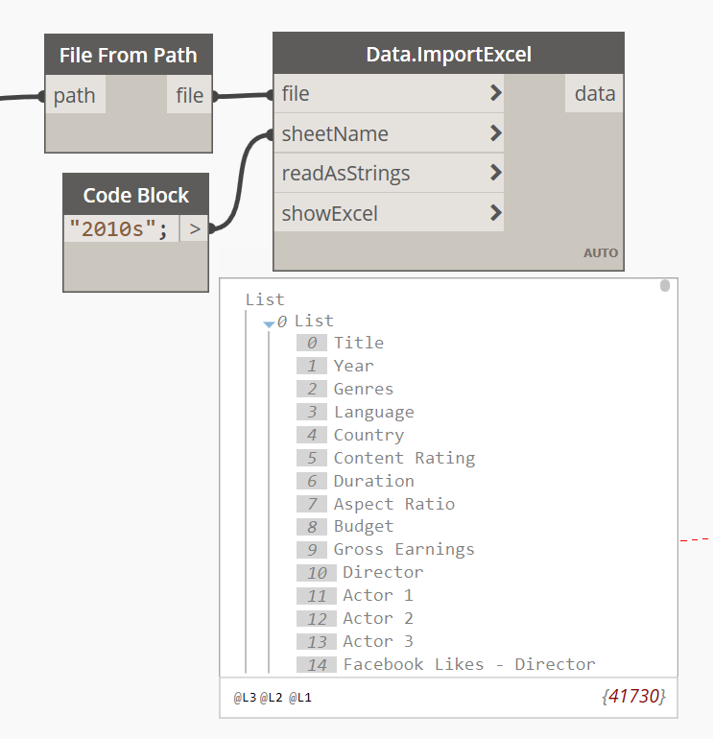
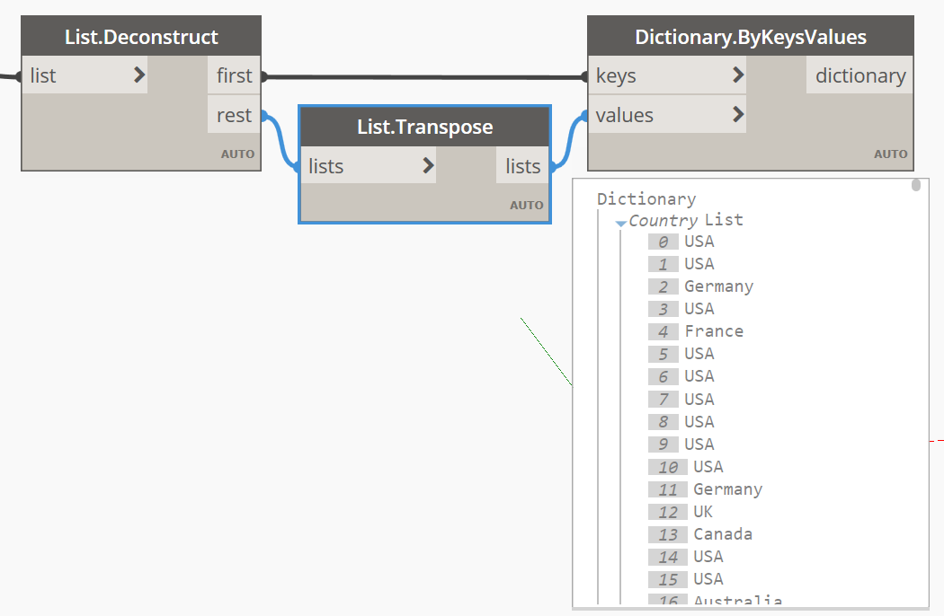
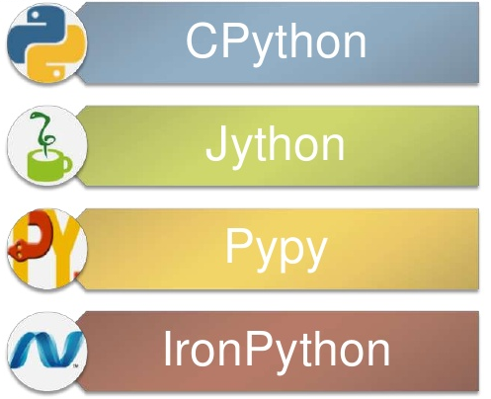
Limitations of Dynamo

Slide 12
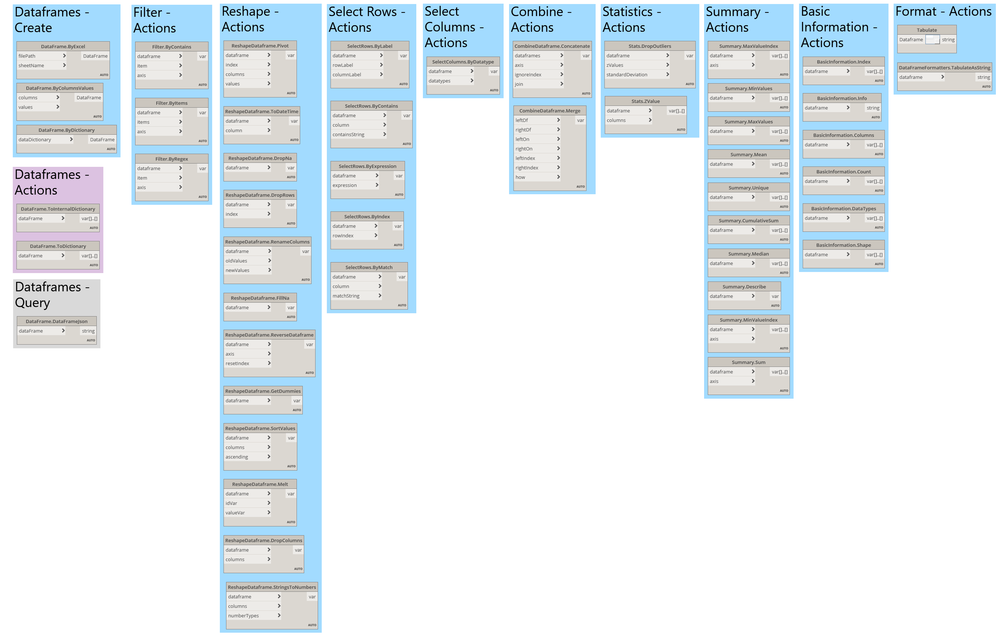
Pandas for Dynamo
Pandamo
Pandas for Dynamo
49 nodes – broken down by 10 categories
1 view extension to connect Dynamo with Python

Slide 13



The Tech
View Extension
Zero-Touch Nodes

